Slide 1
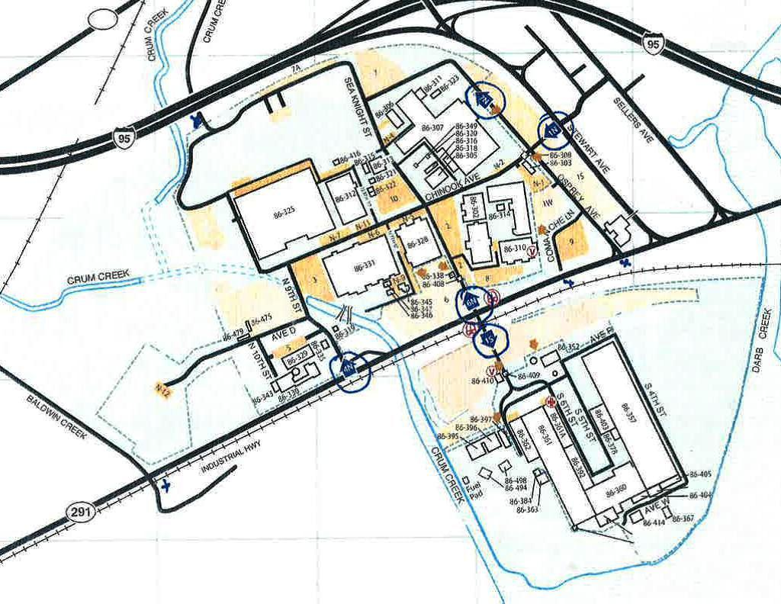
Gate #6
Gate #5
Gate #3
Gate #4
Gate #2
Gate #1
Gate #1 Rt291 PECO Gate #2 Rt291 South Side
Gate#3 Rt291 North Side Gate#4 Rt291 Building 310
Gate#5 Rt291 Credit Union Gate #6 Stewart Ave

